Slide 1
Transparency, Accountability & Trust: Examining the Public’s Evolving Relationship with Parliamentary Ethics Laws in Canada
Ian Stedman
Lawyer and PhD Candidate,
Osgoode Hall Law School
ianstedman@osgoode.yorku.ca

Slide 2
OVERVIEW
1. History of the Rules
2. Transparency & Accountability
3. Conflict of Interest and Ethics Commissioner
4. Ongoing Ethics Controversies: PM's vacation
5. Cash-For-Access
6. Identifying a Trend
7. Oversight 2.0 - What is Changing?
8. How is Government Responding?
9. Is There Hope?

Slide 3
A BRIEF HISTORY
1994: Office of the Ethics Counsellor
- Howard Wilson
2002: Sponsorship Scandal
2004: Office of the Ethics Commissioner
- Bernard Shapiro
2007: Office of the Conflict of Interest and Ethics Commissioner - Mary Dawson

Slide 4
TRANSPARENCY & ACCOUNTABILITY
Elected officials receive confidential advice from an appointed (& unelected) “independent” commissioner.
Advice is based on interpretation of intentionally vague rules.
What social science data informs the advice that influences members’ behaviour?

Slide 5
THE CONFLICT OF INTEREST AND ETHICS COMMISSIONER
Duties:
1. Provide confidential advice.
2. Review confidential reports.
3. Make information available.
4. Investigating possible contraventions
(called “examinations” under the Act and “inquiries” under the Members’ Code).
5. Reporting to Parliament.

Slide 6
THE PM’S VACATION
Aga Khan is a family friend.
Family Vacation to private island.
Government jet to get to private helicopter to get to island.
Didn’t clear it with the Conflict of Interest and Ethics Commissioner first.

Slide 7
WHAT IS THE RULE?
Travel
s. 12 No minister of the Crown, minister of state or parliamentary secretary, no member of his or her family and no ministerial adviser or ministerial staff shall accept travel on non-commercial chartered or private aircraft for any purpose unless required in his or her capacity as a public office holder or in exceptional circumstances or with the prior approval of the Commissioner. (emphasis added)

Slide 8
CASH-FOR-ACCESS
Chrétien caps corporate and union donations & adds public subsidy.
Martin’s tenure plagued by Sponsorship scandal.
Harper lowers limits, eliminates donations from unions & corporations and keeps subsidy.
Subsidy payments eliminated in 2011 & individual contribution limits ramp up.

Slide 9
TRUDEAU’S DILEMMA
2015 election takes place without corporate and union donations or public subsidy.
Liberals host $1525/head fundraisers behind closed doors.
No public record of who attends.
Special benefits for some donors.

Slide 11
WHAT IS THE TREND?
Vacation:
Why wasn’t the trip cleared with COIEC?
Why did you take a helicopter ride?
“…I look forward to answering any questions she may have.” Is the COIEC (who you renewed) now serving as the public’s proxy?
Fundraising:
Who is there?
What are you talking about?
Do they have business with the government?

Slide 12
OVERSIGHT 2.0
Social media.
Access to information.
Online activism.
Accessible and engaged experts.
Journalism is changing.
Public opinion doesn’t wait for the appointed commissioner’s opinion.

Slide 14
KIM CAMPBELL
“Journalism also serves as a conduit for the findings of academic research to the public, creating an accessible bridge between the deep research of scholars and issues and interests of the public."

Slide 15
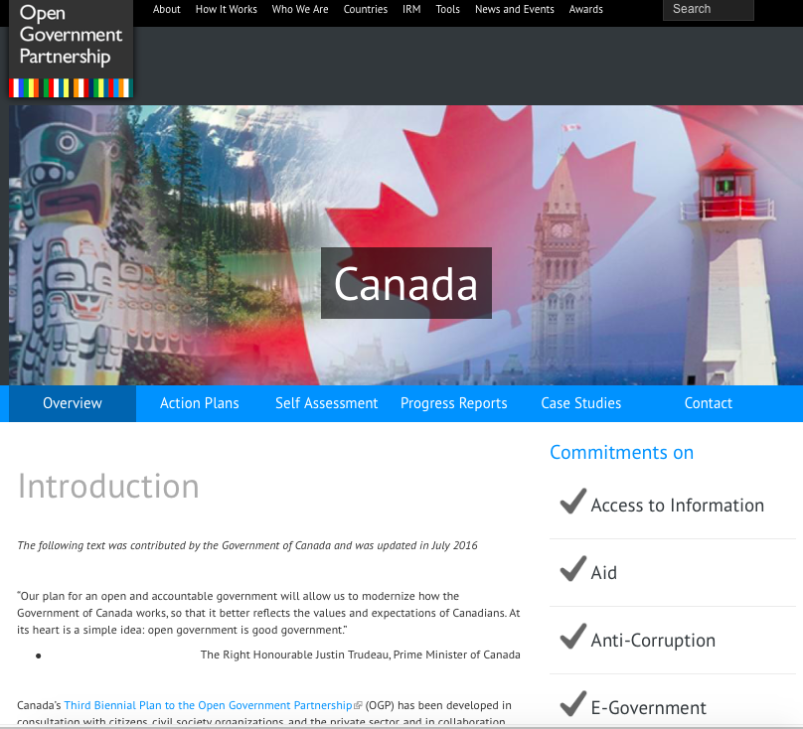

Slide 16
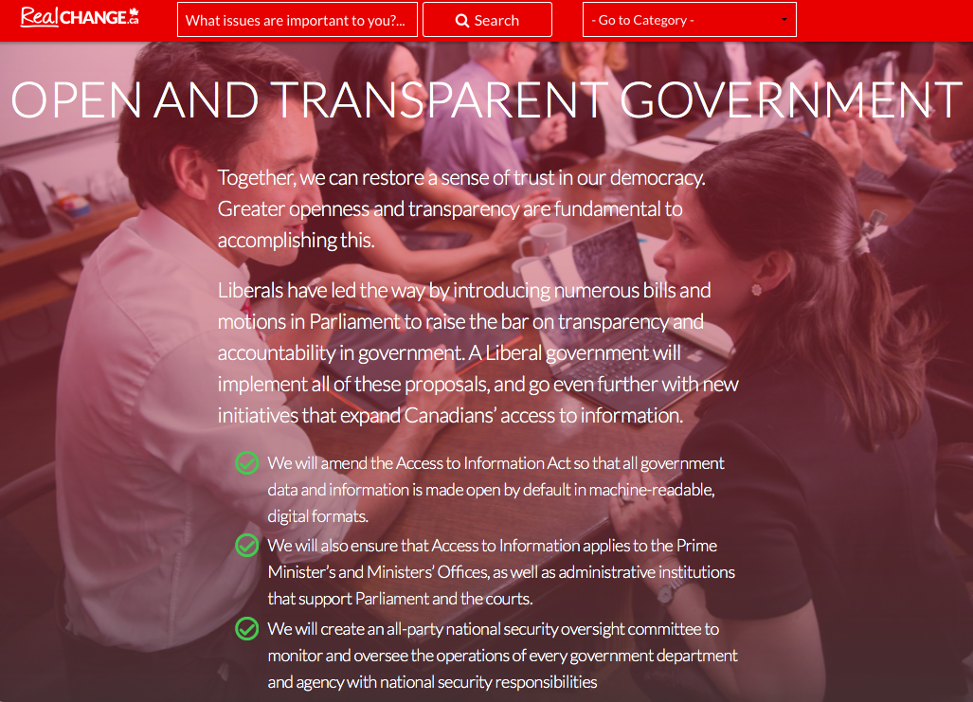

Slide 17
GOVERNMENT RESPONSE
Election promises
Open Government Partnership
Action Plan on Open Government 2016 says that government will “[f]oster enhanced citizen participation through greater collaboration and co-creation with the public and stakeholders within and across government initiatives”.

Slide 18
GUIDELINES FOR CABINET
Ministerial Conduct: Cabinet ministers “have an obligation to perform their official duties and arrange their private affairs in a manner that will bear the closest public scrutiny. This obligation is not fully discharged merely by acting within the law.”

Slide 19
WHY SO MANY “SCANDALS”?
Duffy trial reveals ethics gap in PMO, The Chronicle Herald, 2015
A $486 Ethics Complaint Puts Ottawa in Pre-Election Lobby Chill, Bloomberg, 2015
Ethics watchdog revives investigation into Nigel Wright’s secret $90,000 payment to Mike Duffy – The National Post, 2016
“Cash-for-access organizers sought payments that exceeded federal contribution limits” – The Globe and Mail, 2017
RCMP investigation into Pamela Wallin's expenses handed to Crown – CTV News, 2015
“More Liberals reimburse moving expenses following top aides’ apology”- The Star, 2016
“Canada’s Trudeau faces ethics probe over Bahamas trip”
– The Japan Times, 2017
Parm Gill, Conservative Candidate, Investigated By Elections Commissioner, The Huffington Post, 2015
Ethics commissioner says former Tory policy adviser broke conflict rules – CBC News, 2015
“Rona Ambrose was vacationing on billionaire’s yacht during Justin Trudeau vacation scandal” – National Post, 2017
Crown drops Senate expense charges against Patrick Brazeau- CityNews, 2016
Finley broke rules to fund project submitted by Ottawa rabbi, ethics boss says – Ottawa Citizen, 2015
“NDP asks election watchdogs to probe Liberal donation reports” – The Globe and Mail, 2017
Retired Senator Mac Harb won't face criminal trial over expenses – CBC News, 2016
Liberal MP Kate Young's letter to the CRTC was improper: ethics commissioner, MetroNews, 2016

Slide 20
CAN WE BRIDGE THE GAP?
Parliamentary ethics oversight infrastructure is relatively young and still being tested.
We are seeing a major evolutionary shift in how governments must operate.
Laws in place didn't contemplate this shift from representative to participative democracy.
Must add sunset clauses and mandatory public consultation.

Slide 21
THANK YOU.
Email: ianstedman@osgoode.yorku.ca
Twitter: @IStedman
LinkedIn: www.linkedin.com/in/istedman

